Slide 1

Nan Mudhalvan Project:Digital Marketing
Work hive: Social ads
Break your shackles of poverty with us !!

Slide 2

Introduction:
We have chosen a project in the Community level to elevate the lives of people below the poverty line by aiding them to search a suitable job related to their set of skills using the forum Work hive.
This project aims to illuminate their skills and be better in their field of expertise.
Many companies those of Start-ups are also benefited by this project. To add upon, different sectors are covered in this project which includes people with different skills.
The main outcome of this forum is to establish these people in their respective fields.

Slide 3


Background:
Justice for the Act of Remuneration.
Helping people to stabilize their lives.
Declination of Poverty (If done in a long-term process).
Establishing and encouraging Start-ups.

Slide 4
Working of the project:
There are essentially three steps which must be completed in order to make this project a winner. The three steps are mentioned below:
Research about the people: (Field work-Data collection and storing)
Wages they expect and get are analysed.
Skills, Educational Qualification and experience they are equipped with.
Analysis about their Hives:
Linking people and company workers:

Slide 5
Role of branding:
Start-ups, Jobs and Companies are identified. After that we discuss about their requirements and their demands.
Advertising via Social media platforms.
Instagram is the desired platform to upload.

Slide 6



Steps to create an ad poster:

Slide 7
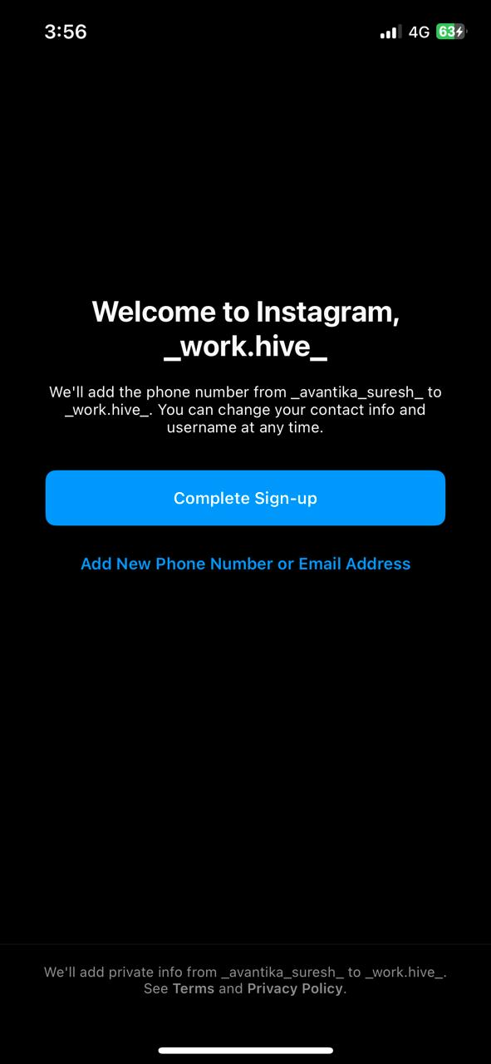


Posting a sponsored ad:

Slide 8
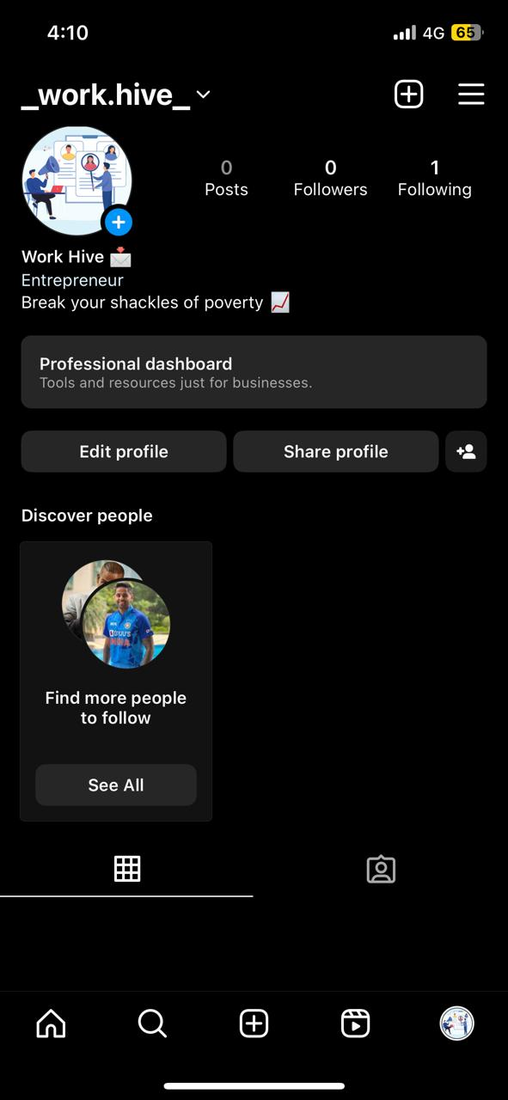
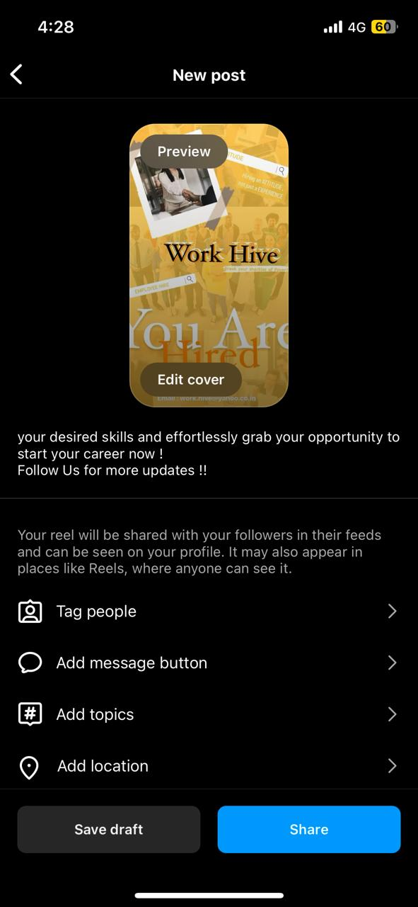
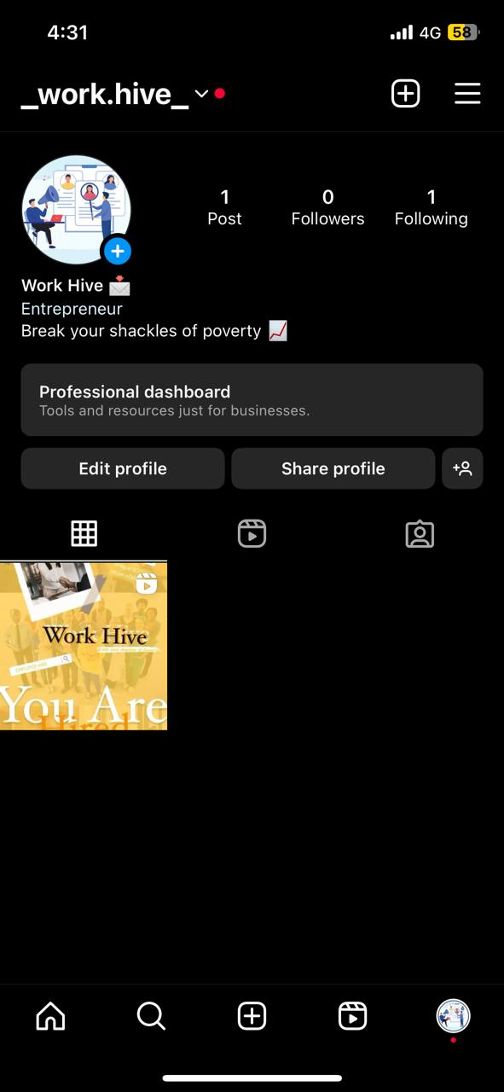
Posting a sponsored ad:

Slide 9
Outcomes:
Improvising lives of people under the poverty line.
Satisfying workers with their Jobs.
Encouraging Self-employment and Start-ups.
Increasing productivity because of content workers.
Removing agents commission and influencing remuneration.
Developing skills and equipping people with new skills.

Slide 10

Thank You !

